Slide 1
AI Detection and Processing of Starrag Sound Data
ME 597II – Midterm Presentation
Agathiya Tharun
Ayush Viswanathan
Supported by:
John Murphy
TAMS & Maijker Corp.

Slide 2
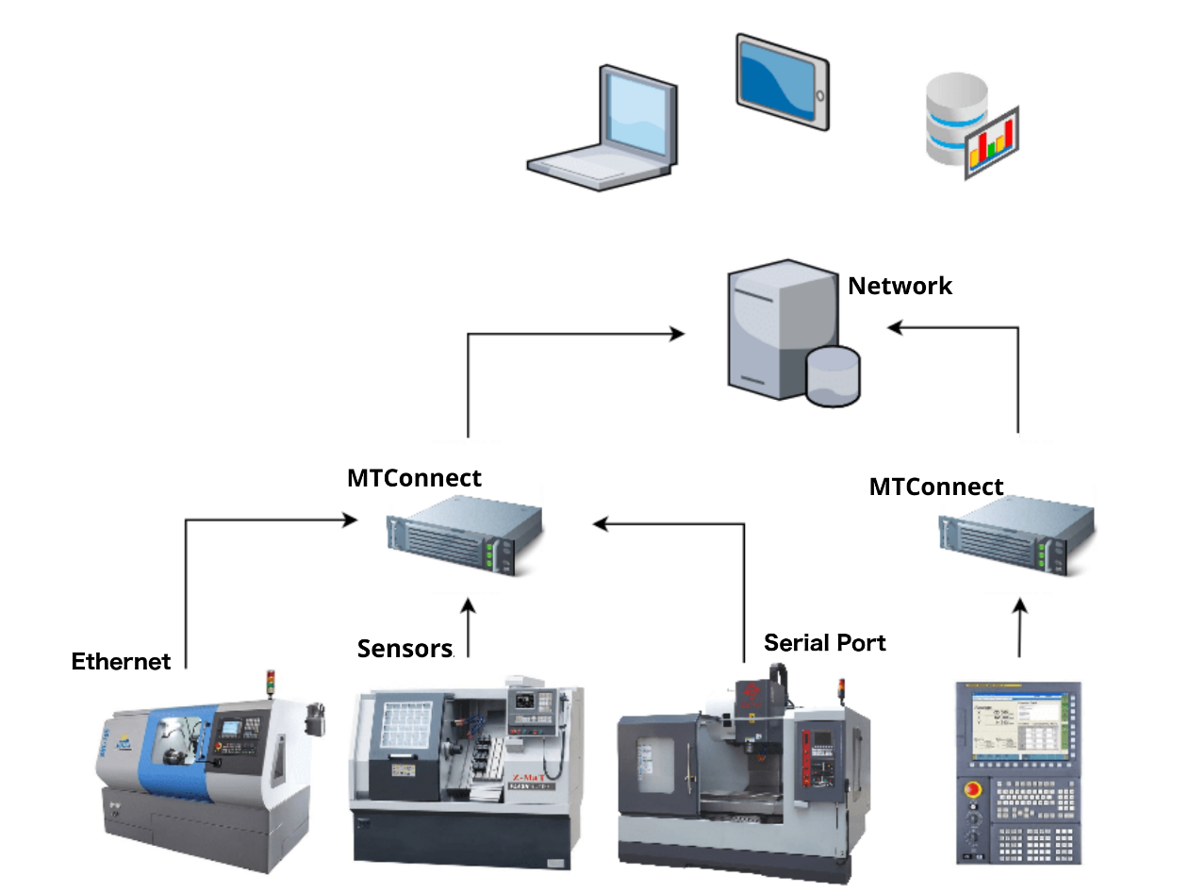
Background
Maijker
TAMS
RND of AI and IoT applications
Collaboration with manufacturing companies and universities
Proprietary sensor development coupled with AI
Machine monitoring
Maijker partner
Resolves MTConnect implementation issues
Supporting data collection initiatives

Slide 3
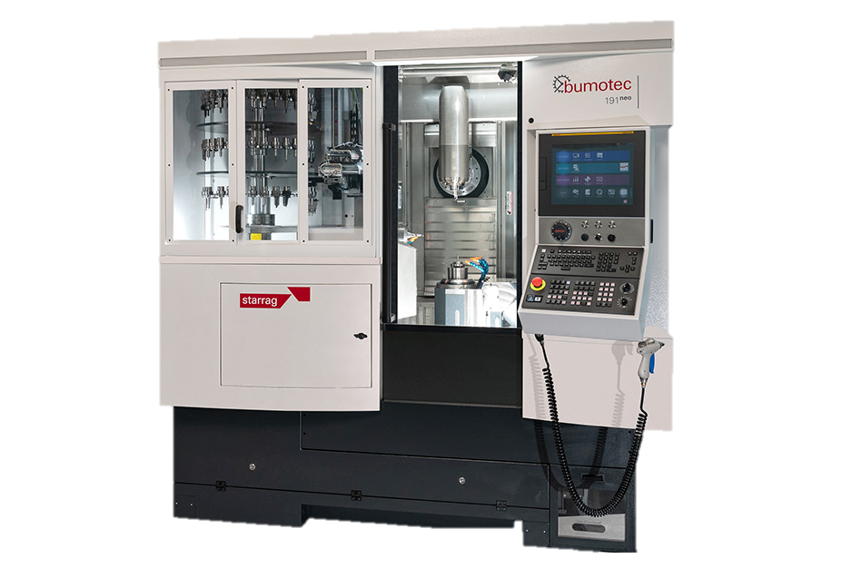
Problem Description
Starrag Bumotec 191 Neo Machine
High-precision multifunctional machine
Requires close monitoring
Downtime at Starrag can cost millions
Rising demand in the manufacturing field

Slide 4
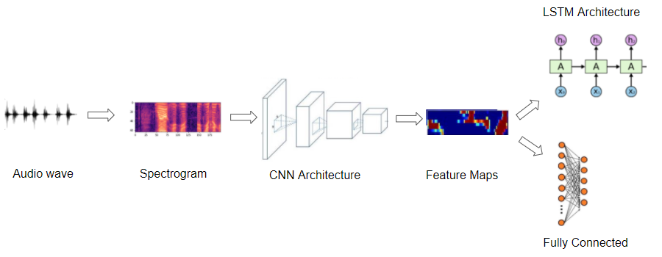
Project Goals
Develop a preprocessor to create data compatible with the autoencoder
Create a ML model
Test the autoencoder
Develop a functional framework to detect anomalies in sound

Slide 5
Current Approach
System Flow Chart
Understanding Project Scope
Gathering Relevant Audio Data
Preprocess Audio .wav file dataset
Determine Normal/Abnormal Thresholds
Build and Train Machine Learning Model
Conduct Feature Extraction
Retrain/Optimize Machine Learning Model
Test ML Model
Present to Customer
Notes:
The current approach can be seen through the system flow chart above. We spent the first couple of weeks setting up meetings on the project with John and understanding the project scope of the Starrag project. The next step in the process to gather the relevant audio data. In our case, it is .wav audio files gathered from the Maijker sound sensor on the LX21 machine.

Slide 6

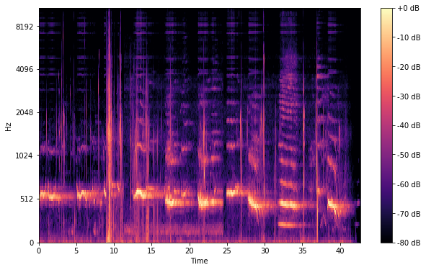
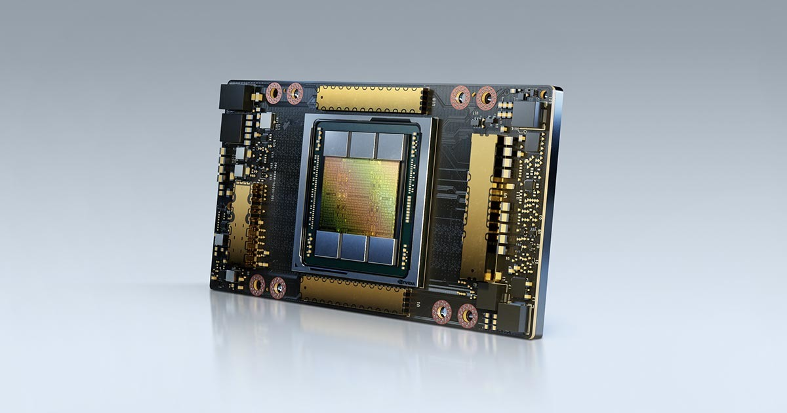

Current Approach
Identification of Requirements
Software
Python Libraries – Tensorflow and Keras
Maijker Machine Learning Library
Access to Audio .wav file datasets and melSpectrograms
Hardware
Access to good GPU for training model
Requires high ram and computing power
Google Colab for Training

Slide 7
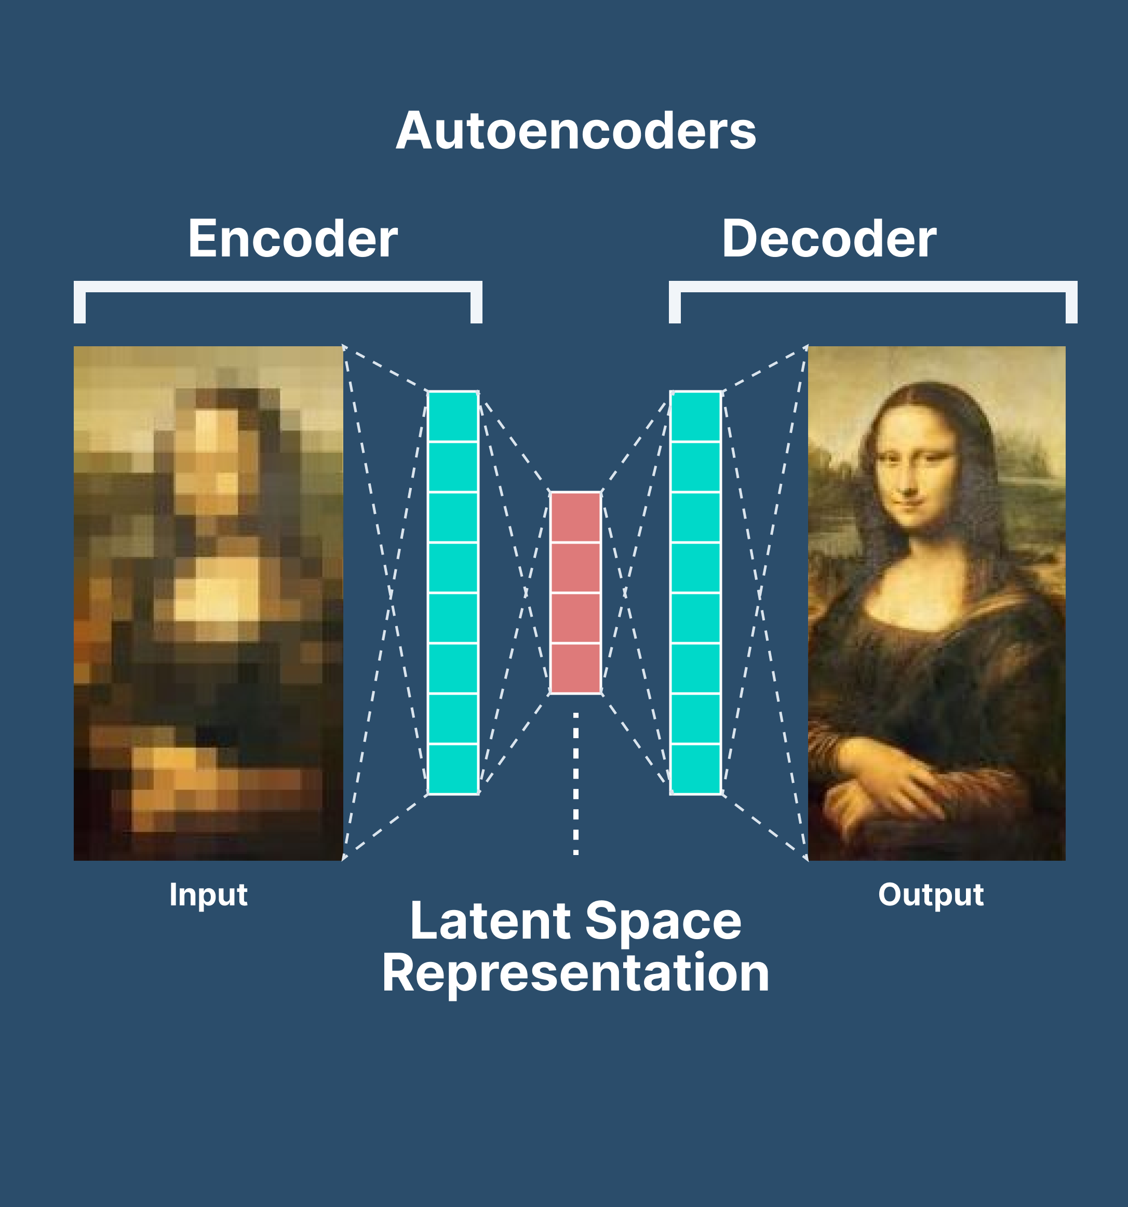
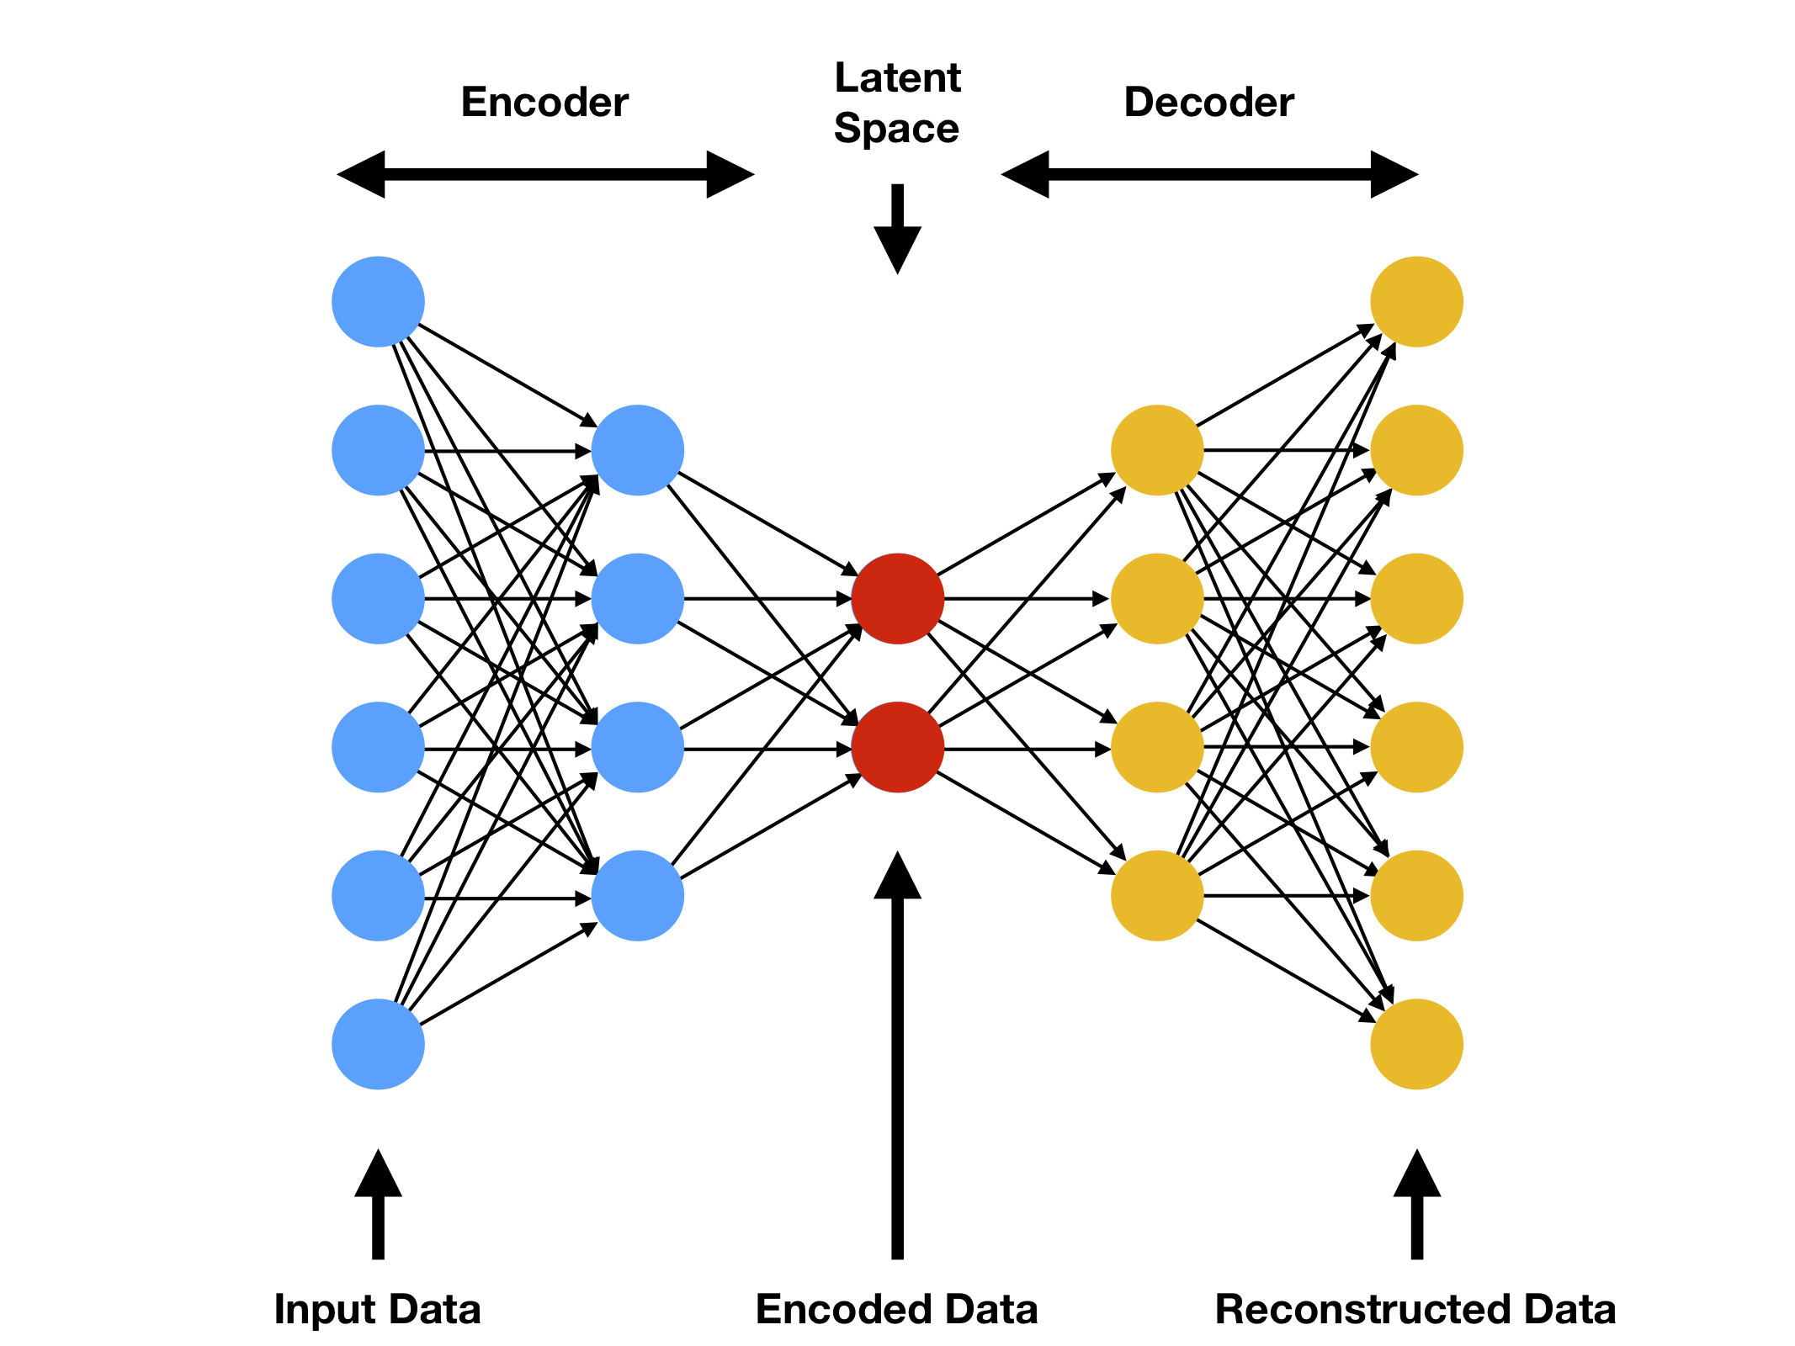
Autoencoder
Basic Theory
Notes:
The main function of an autoencoder is to compress and replicate the input data to create a more efficient and accurate representation of data. There are essentially 2 fully-connected neural networks: the encoder and the decoder. The encoder compresses the input data into a latent-space representation, typically of lower dimensionality, capturing the most important features of the input. This compressed representation is then fed into the decoder, which attempts to reconstruct the original input data from this representation. The objective of training an autoencoder is to minimize the difference between the input and the reconstructed output, also known as reconstruction error. The main application of Autoencoders is to accurately capture the key aspects of the provided data to provide a compressed version of the input data, generate realistic synthetic data, or flag anomalies.

Slide 8
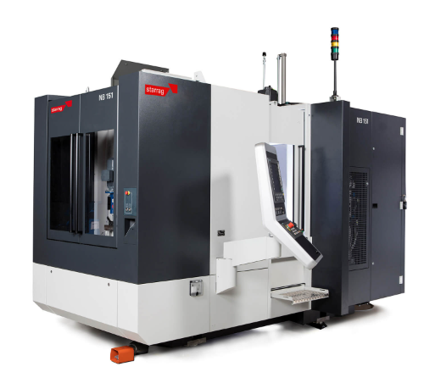
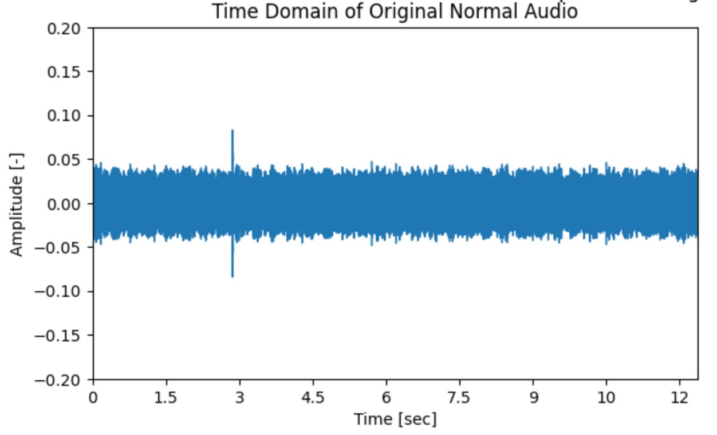
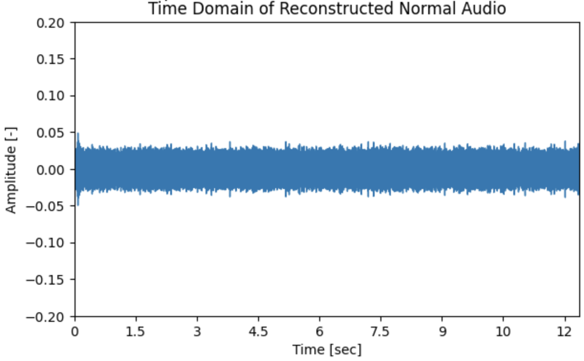
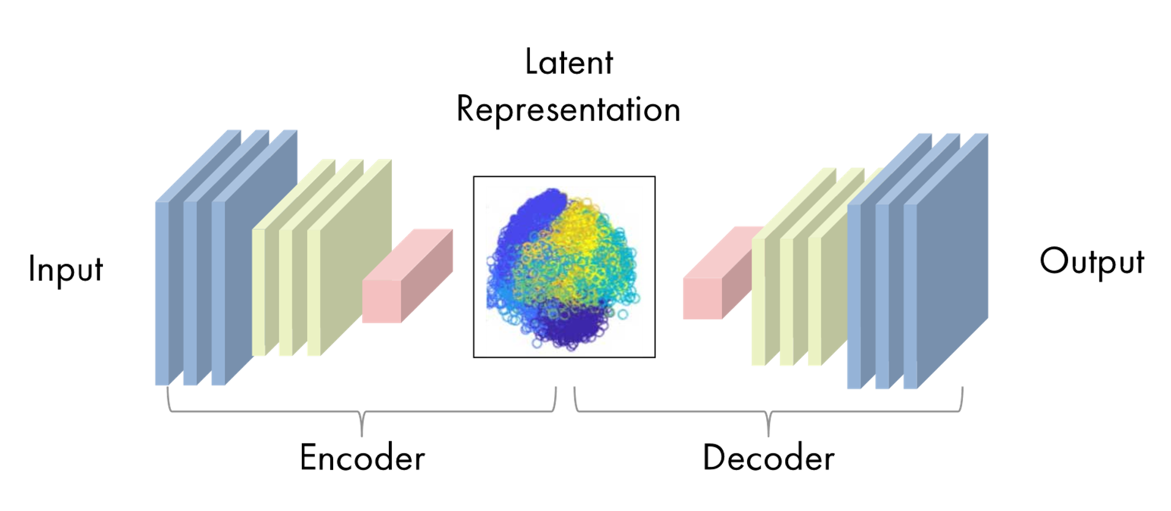
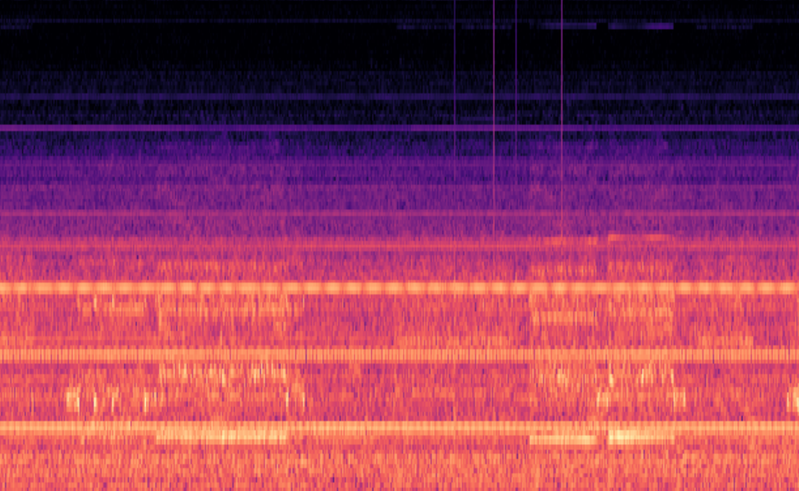
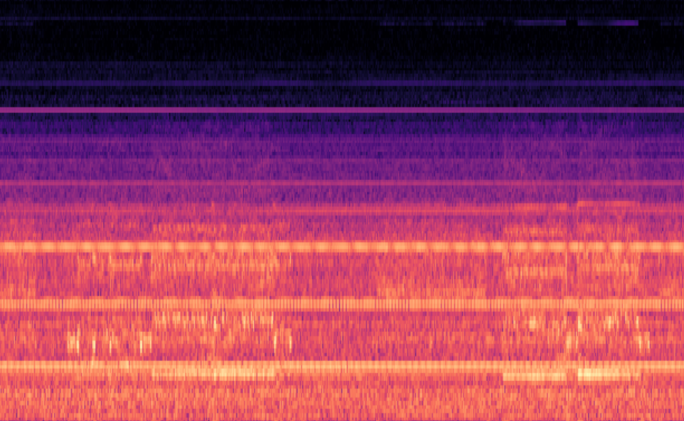


Autoencoder
Convolutional Autoencoder
0.014
Healthy
Reconstruction
Error
Notes:
Explain convolutional autoencoder here

Slide 9
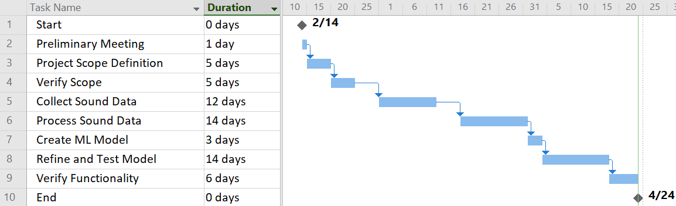
Scheduling
Updated
Discrepancies:
Changes in project scope (LX21)
Data collection issues
MAC address recognition
Notes:
Things that may affect schedule. Ultimately implement into bumotec

Slide 10
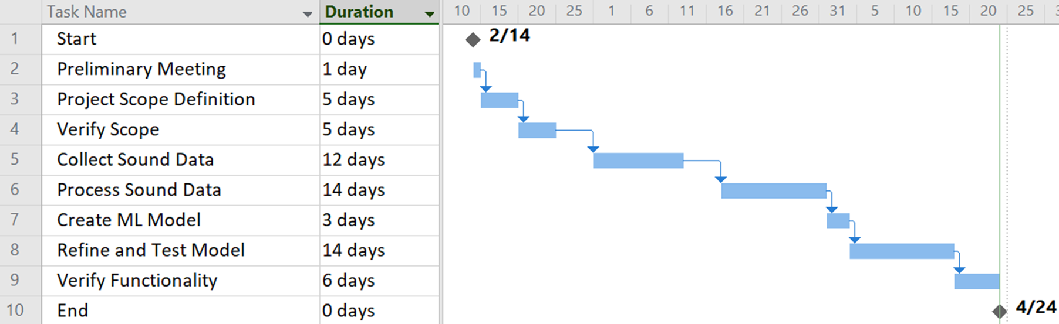
Scheduling
Updated
Discrepancies:
Changes in project scope (LX21)
Data collection issues
Grafana integration issues
MAC address recognition
Notes:
Things that may affect schedule

Slide 11
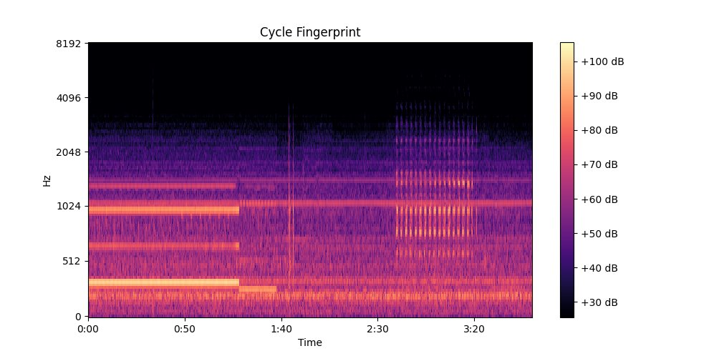
Progress
Data Preprocessing & Feature Extraction
Maijker sound sensor data gathered from TAMS cloud server
Feature extraction of a spectrogram from a WAV file using librosa library
Audio .wav file
melSpectrogram
Notes:
A mel spectrogram is a visual representation of audio data in the frequency domain, particularly useful for analyzing speech and music.

Slide 12
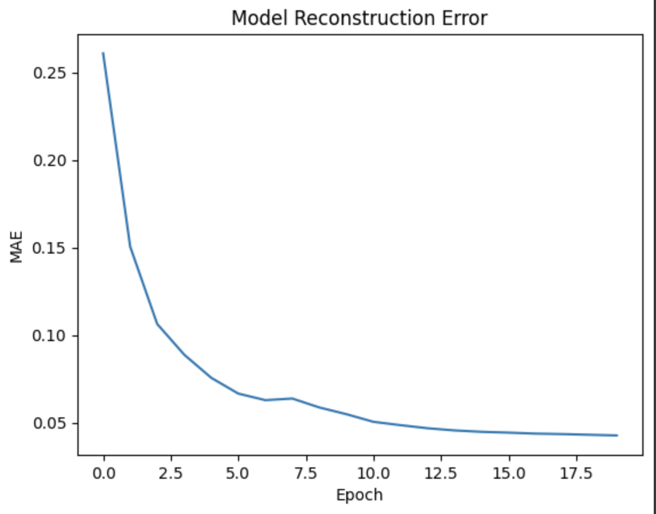
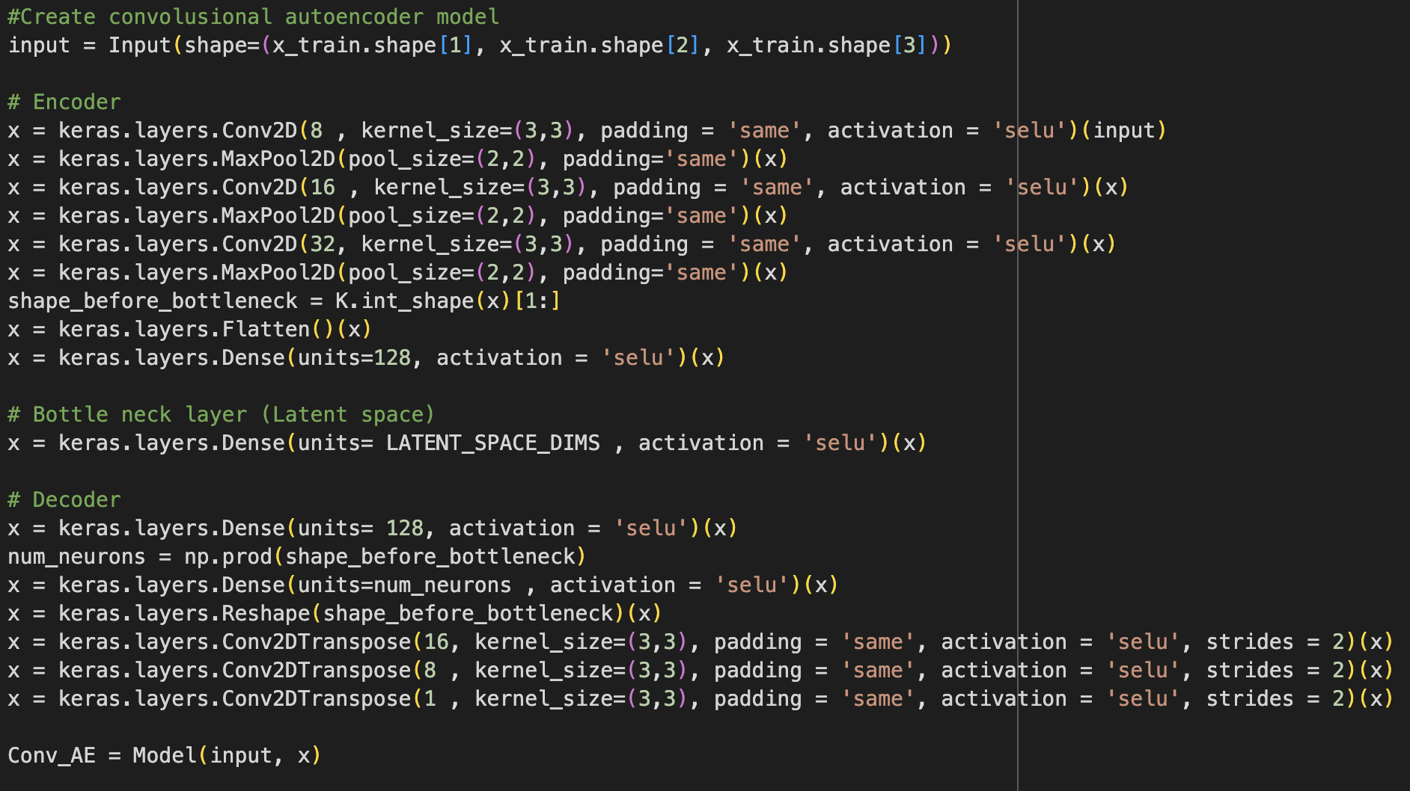
Progress
Autoencoder Model
Convolutional Autoencoder
Latent space size of 2
Reached a reconstruction loss of 0.0427 after 20 epochs
Lack of time led to inability to iterate training and testing of the model

Slide 13
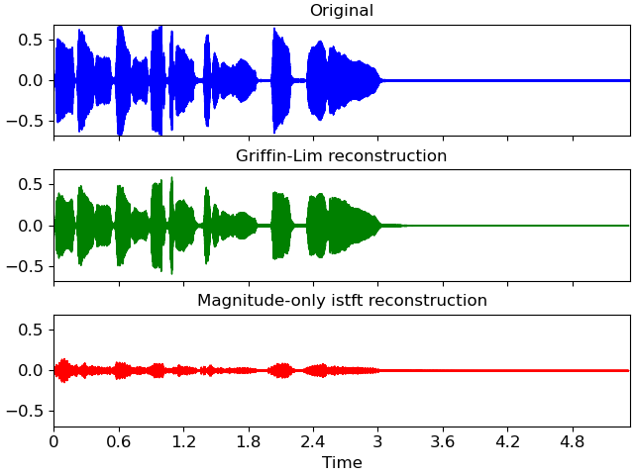
Progress
Reconstructed spectrogram to WAV file
Denormalized melSpectrogram data and converted to spectogram
Utilized Griffin-Lim Reconstruction to convert spectrogram into a time-series WAV file

Slide 14
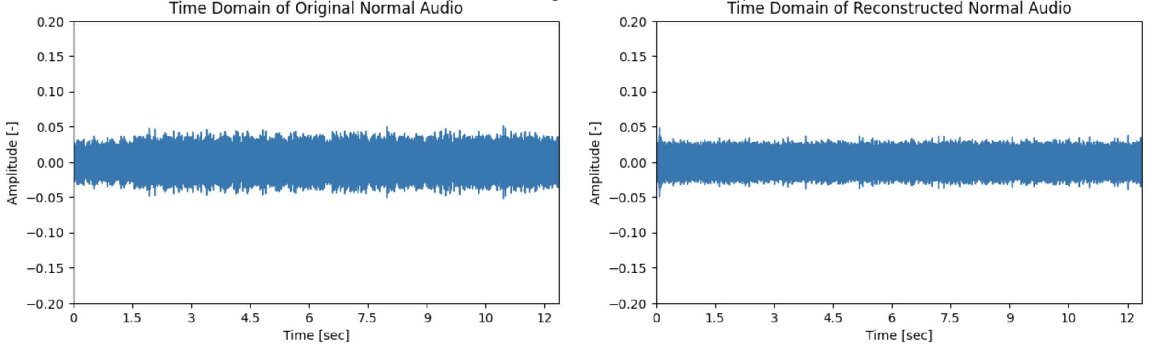
Progress
Original Audio vs. Reconstructed Audio

Slide 15
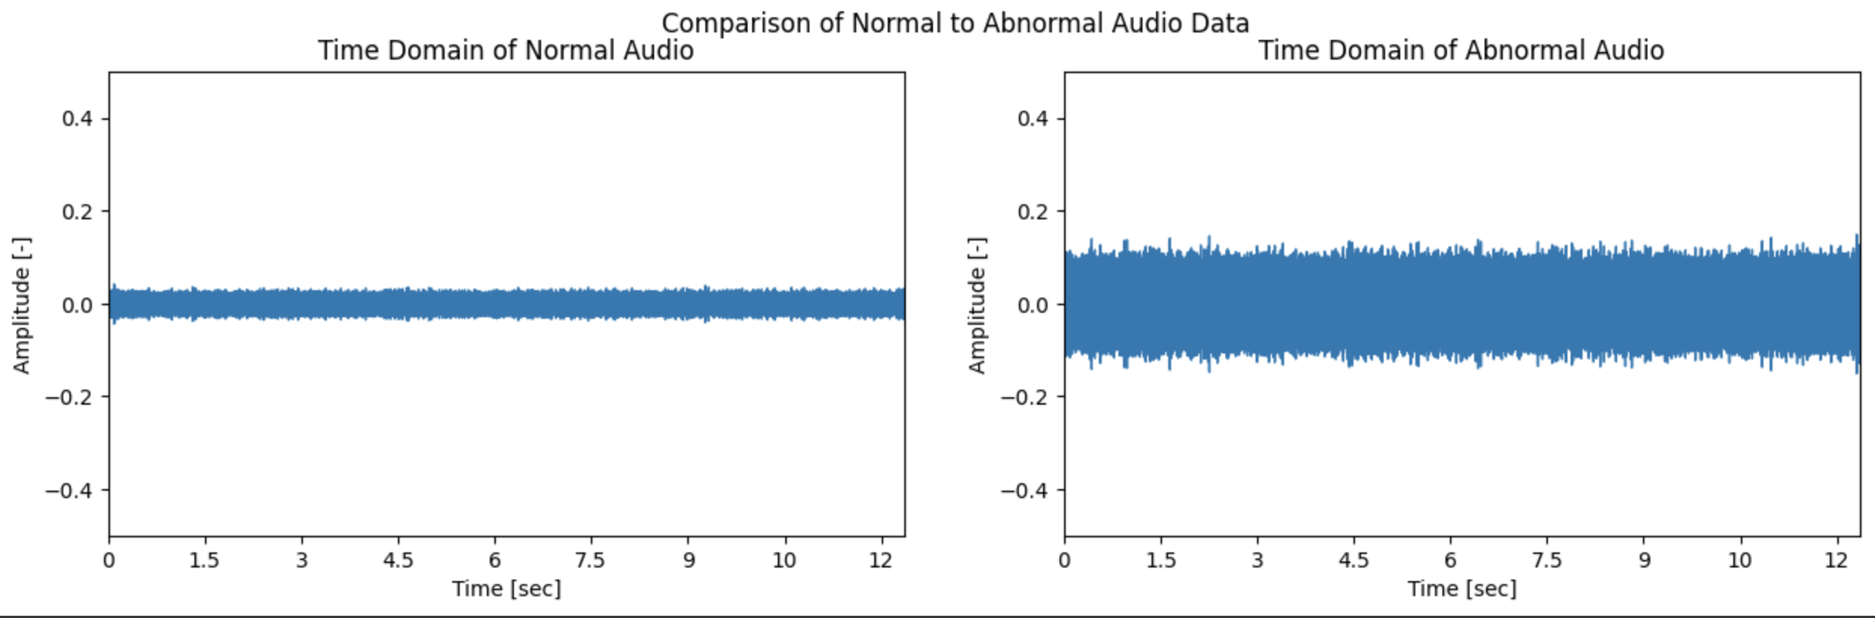
Progress
Normal Data vs. Abnormal Data

Slide 16
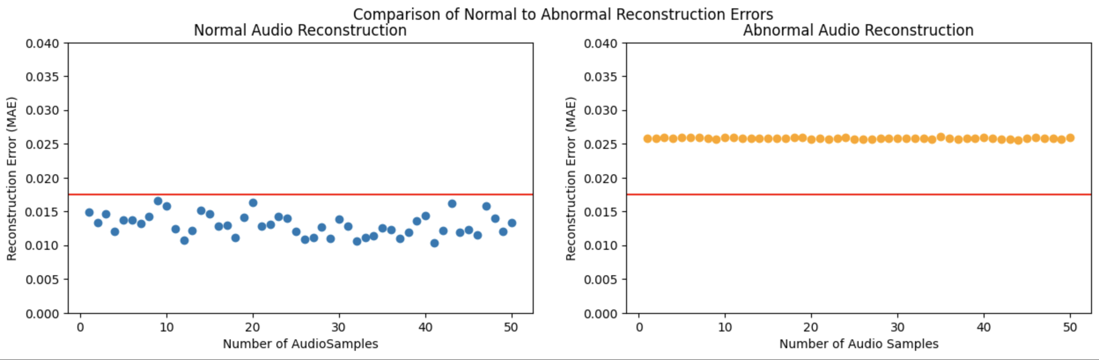
Progress
Thresholding and MAE Graphs
MAE Reconstruction Threshold = 0.0177

Slide 17
Project Progress
Current Stage
Understanding Project ScopeX
Gathering Relevant Audio Data
Preprocess Audio .wav file dataset
Determine Normal/Abnormal Thresholds
Build and Train Machine Learning Model
Conduct Feature Extraction
Retrain/Optimize Machine Learning Model
Test ML Model
Present to Customer

Slide 18
Challenges
Lack of live data for the LX21
Limited time
Inability to create a dataflow to Grafana
Attempted to use local data
Grafana network errors
Avoided Grafana
Lack of time to retrain and test autoencoder model
Visible difference between input and reconstructed input

Slide 19
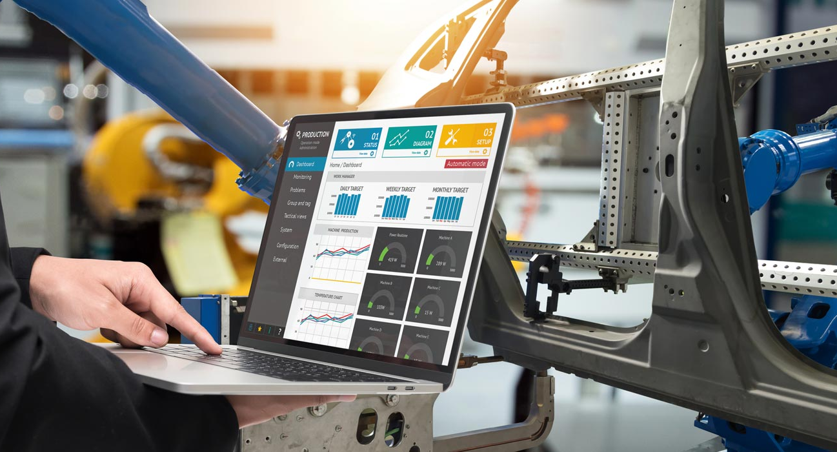
Project Benefits
Proactive maintenance
Preemptive troubleshooting
Reduced downtime
Detailed feedback
Continuous monitoring
Optimized performance

Slide 20
Conclusion
Final Takeaways and Next Steps
Final Takeaways
melSpectrogram will require modifications to the autoencoder model
LX21 autoencoder will be a good model for Bumotec machine
Sound data is difficult to process
Future Improvements
Can further refine the autoencoder model
Create a scalable architecture to work with more machines
Incorporate handling for live data
Develop a Grafana dashboard to display live data

Slide 21
Thank You

Slide 22
Problem Slides
Company Background - Applications
Motivation for Problem
Problem Description
Mention the fact that we went from 191neo to LX21 to practice on the data due to delays
Proposed Approach
Problem Scope/Project Goals
Utilize some kind of flow chart with images
Flow chart of current approach (keep it general and talk about auto encoder, etc.)
Identification of Requirements (GPU, software, python libraries, datasets, etc.)
Mention auto-encoder and how it works
Mention 2 types of auto encoders we are considering to use (LSTM auto encoder and Convolutional auto encoder) and pros/cons
Project Planning
Slide explaining planning (break it into stages or import Gantt chart), task distribution, and number of visits/interactions
Project Progess
Mention what stage we are in
Slide of data preprocessing - include melspectrogram image
Slide of data preprocessing
Slide on anticipated challenges
Conclusion
Benefits on the Project - few bullet points / images that explain benefit and realistic outcome for company
Conclusion Slide - final takeaways, future steps, etc.
Thank you
Thank you slide

